Slide 1



The Challenges for a Knowledge-based Profession: how can we empower teachers with the latest educational research?
Linda la Velle
Towards the development of deeper learning and transferable lifelong skills through the use of European Key Competencies
Santiago de Compostela, Galicia, Spain 17th June, 2013

Slide 2
Focus of Talk
What are our Challenges?
Why have they come about?
What is different in 2013?
Imagine if……..
How can we work differently?
An invitation to get involved!
Notes:
Challenges for teachers, teacher-educators, teacher education policy makers in a knowledge-based society to create knowledge-rich, evidence-based educational systems.
New ways of working to improve learning outcomes:, international, collaborative, using existing resources effectively to:
pool research-based knowledge particularly Pedagogic Content Knowledge
identify gaps in PCK and other areas needed to improve learning outcomes,
scale up small scale research and
publish in new ways which are relevant and accessible to the teacher in the classroom

Slide 3
Our Challenges
Underachievement
Teacher accountability vs autonomy
Need for personalisation
Cost of CPD
Theory/practice links
Digital futures
Relevance of research evidence
Notes:
Underachievement: long tail; widening gap between highest and lowest achievers – has been focus of many recent political initiatives in UK under successive governments in recent years.
Centralised control: criticality and credentialism
Accountability varies between countries but currently:
UK has high stakes school inspection; academics judged on impact, reach and significance for UK (Research Excellence Framework)
In the USA (and UK) teacher educators are judged on how their newly qualified teachers perform in the classroom
Personalisation: need to personalise learning for each child, which means personalised development of teachers because of their different needs and the obvious use of the web for this. Personalisation (otherwise called differentiation or adaptation) of learning is a professional ability of the teacher that has assumed increasing importance in recent years, featuring in the development of curricula across the world. Arguably one of the most difficult of skills to acquire when the novice teacher has so many factors to take into account at each stage of the pedagogic cycle, it is perhaps the professional characteristic that brings teaching onto a par professionally with, for example, medical and legal practitioners. In this issue, McLean Davis et al. describe an Australian initiative characterised by the development of skills of interventionist practice, high-level analytic ability and capability to use data and evidence to address the needs of individual learners. This clinical approach to the education and training of new teachers demonstrates not only the professional characteristics of knowledge bases, teacher action, the community of practice, but also the centrality of clients (patients/pupils), the exercise of clinical and ethical judgement and use of evidence in practice. Linking theory and practice in this way, the Melbourne-based Master of Teaching qualification exemplifies the notion of teaching as an intellectual and moral activity of the highest order of professionalism.
The move of teacher education/training to schools means that teachers in training have less access to articles
Too many articles report research which is small scale and so is difficult to know whether it is worth changing practice. Research syntheisis methods are only of use where articles are written to a high standard so there can be comparisons between articles.
Cost of CPD for teachers
Theory/Practice Links: teaching as an intellectual activity; learning to teach linked to HE; educational theory contextualised to each teacher’s practice.
Digital Futures: new opportunities afforded by advances in technology
Educational Research: Criticism of relevance of educational research. Broad church. As a sector we have a poorly organised knowledge base.
Would the medical, legal, aero-engineering professions find the standard of our evidence base acceptable?
Messages for university staff about how to improve the evidence base for their research within current financial constraints, how they publish so that users (politicians and practitioners) can use their work as a foundation for decision-making and how they decide on what is worth researching in the first place

Slide 4
OECD Challenge
The Organisation for Economic Cooperation and Development
calls for the:
“creation of ‘knowledge-rich’, evidence-based
education systems,”
because…
“in many countries, education is still far from being a knowledge industry in the sense that its own practices are not yet being transformed by knowledge about the efficacy of those practices.” (OECD, 2009, p.3)
So…..
Do we need to work differently?
Notes:
The answer is yes if we believe that evidence-based practice improves outcomes.
Plus cpd challenge and change over 40 yrs Knowledge is not static, new knowledge needs to be created, tested, published Plus in complex societies with few unskilled jobs, to maximise harnessing of the talents in the population, the goal is for learners to learn better, faster - no child left behind, personalisation, tracking individual attainment, holding teachers accountable for progress of individuals -

Slide 5
The European LLL Challenge
Key Competence 4/8:
digital competence involves the confident and critical use of information society technology (IST) and thus basic skills in information and communication technology (ICT);
KCs to be acquired by adults throughout their lives, through a process of developing and updating skills. Implications for professional knowledge and CPD.
Notes:
Key competences in the shape of knowledge, skills and attitudes appropriate to each context are fundamental for each individual in a knowledge-based society. They provide added value for the labour market, social cohesion and active citizenship by offering flexibility and adaptability, satisfaction and motivation. Because they should be acquired by everyone, this recommendation proposes a reference tool for European Union (EU) countries to ensure that these key competences are fully integrated into their strategies and infrastructures, particularly in the context of lifelong learning
Key competences should be acquired by:
young people at the end of their compulsory education and training, equipping them for adult life, particularly for working life, whilst forming a basis for further learning;
adults throughout their lives, through a process of developing and updating skills. Implications for professional knowledge

Slide 6
The Evidence Challenge
At present we have….
Web based repositories
Systematic reviews: EPPI centre, Campbell collaboration
Silos and dispersed efforts – subject associations, professional associations
But….
Silos mean knowledge is difficult to find
As soon as knowledge is recorded and published it is out of date as practitioners take it forward…
Keeping the knowledge base up to date is massive - there are over 1000 core concepts for trainee teachers to master
Notes:
Where does the research-based evidence upon which teachers can draw to improve their practice actually reside?
Time delay/limited access to evidence by educators
the costs and challenge of on-going professional development for teachers
need for theory/practice links
How do we rise to these challenges?

Slide 7
Why have the challenges come about?
development of the internet to date to support professional learning/knowledge and next steps
current state of play with educational research and knowledge repositories
the goal of evidence based practice to improve pupil outcomes.
access to the evidence base by educators
the costs and challenge of on-going professional development for teachers
importance of theory/practice links

Slide 8
Why have the challenges come about?
Policy Makers’ perspective
Lack of evidence to inform policy
UK RAE and REF and synthesis work shows: small scale, parochial , non-scalable eg synthesis showed 5000 Primary MFL studies…
New opportunities through digital technologies

Slide 9
Why have the challenges come about? Practitioners’ perspective
In the UK:
  High stakes school inspection regime
  academics judged on impact, reach and significance for UK REF (Research Excellence Framework
  teacher educators are judged on how their newly qualified teachers perform in the classroom
In other countries – accountability varies, but in any case: professional, moral and contractual accountabilities apply

Slide 10
What is different in 2013
Low-cost collaboration through on-line communities
QA Wikipedia-type approach:
Crowd-sourcing of data
Profession familiar with web 2 tools
Research gaps identified in UK TDA review of research show fine grained research into pedagogy traditionally is not funded
Lack of research into barriers to learning: misconceptions (threshold/troublesome concepts)
Web publishing allows different ways of publishing ,
  e.g. flowcharts - Identification of problem -> contextual factors -> effective pedagogic strategies

Slide 11
Why? The need to Move from 19th to 21st Century practice
See Leask, M. (2004) Using research and evidence to improve teaching and learning in the training of professionals – an example from teacher training in England www.ttrb.ac.uk
Informal electronic networking
Electronic networks
Rapid dissemination; low cost updating; ease of knowledge-building through on-line communities, across institutions/cultures; extended professionalism
Evidence informed policy/practice
Slow print dissemination; limited publishing opportunities
Pre-electronic networking
Isolated practice/restricted professionalism
Historical oral tradition
Research-led teaching
Notes:
Increased codification of knowledge
Improved R&D

Slide 12
Imagine…if
Trainee teachers and newly qualified teachers could easily access:
research-based pedagogic knowledge about barriers to learning specific concepts and the
pedagogical tools such as explanations, demonstrations, modelling, questioning that experienced and successful teachers use to help learners overcome their personal barriers to learning threshold concepts….
…all at the touch of a button.
Educators collaborated to develop such a quality- assured wikipedia type resource…

Slide 13
Imagine…if
Researchers, research funding bodies, teachers undertaking research could easily
see gaps in the research base
see areas that were well researched
find questions teachers want researched
and cost effectively collaborate across regions to scale up and test out emerging practice in different settings.
Our evidence base for effective practice was based on cumulative research over years, across settings….rather than being small scale, diverse and rarely useful in providing a foundation for practice or policy making.

Slide 14
The Vision
New Practices:
  cost effective methods for scaling up small scale research e.g. iPADS
  online collaboration (national/international) to gather data, share knowledge
  rapid evidence review groups (like the Cochrane Collaboration in Medicine)
  rapid evidence based responses to govt. policy
Access and coverage: thousands of concepts have to be mastered -> access and approach like wikipedia
Connectivity: a flexible e-infrastructure connecting people and communities like the physical network of motorways.
The Education Futures Collaboration
Notes:
Stenhouse’s idea was for synthesis across action research studies using extensive collaborations between researchers and practitioners

Slide 15
The Education Futures Collaboration’s
Response to the Challenges
EFC philosophy is to promote a reflective and collaborative way of working to build and share evidence-based knowledge for educational practice.
EFC goals are to:
support teachers’ professional judgement with evidence
raise learners’ attainment by professionalising teaching
EFC is a ‘Collaboration’ between organisations subscribing to the philosophy, committed to collaboration to achieve the goals and providing a small amount of funding for the e-tools for collaboration.
Notes:
Improving teacher education and learner outcomes is a major challenge for developing and developed countries. So why aren’t policy and practice underpinned by an agreed body of research based evidence?
EFC includes a set of tools to make that happen.

Slide 16
How?
Two new e-tools with the aim of identifying pockets of good practice and joining them up:
  Tool 1 MESH – Mapping Educational Specialist knowHow. – translational research approach - is the shop window www.MESHguides.org
  Tool 2 Education Communities www.educationcommunities.org support low cost online international collaboration processes
Notes:
The Education Futures Collaboration is an independent umbrella organisation
Pockets of good practice:
Coalition for Evidence Based Research in Education (CEBE) Jon Sharples and Estelle Morris (York)
TTRB - Mike Blamires (Christchurch Canterbury)
Joining up the parts:
We have started this process

Slide 17
= a way of working differently
Translational research – medical profession: ‘bench-top to bedside’
Thousands of Google entries….but not for education
EFC definition: ‘concept to classroom’ – a different writing style, different forms of access and a different form of publication is needed.
Translational research in education – that which makes a direct link between concepts, theories and classroom practice
EFC, through an innovative system ‘MESH’ aims to produce and publish translation research in education on a global scale, through mass participation as in wikipedia

Slide 18
Other professions
The medical profession is ahead of the education sector in harnessing digital technologies to support the building and sharing of research-based knowledge.
Through collaborations such as Map of Medical Healthguides, the Cochrane Collaboration and the UK National Institute for Health and Clinical Excellence (NICE), policy into practice has strengthened, so-called translational or “benchtop to bedside” research.

Slide 19
Working differently: EFC e-tools
Two new e-tools
Tool 1 MESH – Mapping Educational Specialist knowHow. – translational research approach - is the shop window www.MESHguides.org
Tool 2 Education communities www.educationcommunities.org support low cost online international collaboration processes
The big goal - Identify pockets of good practice
and join up the parts

Slide 20
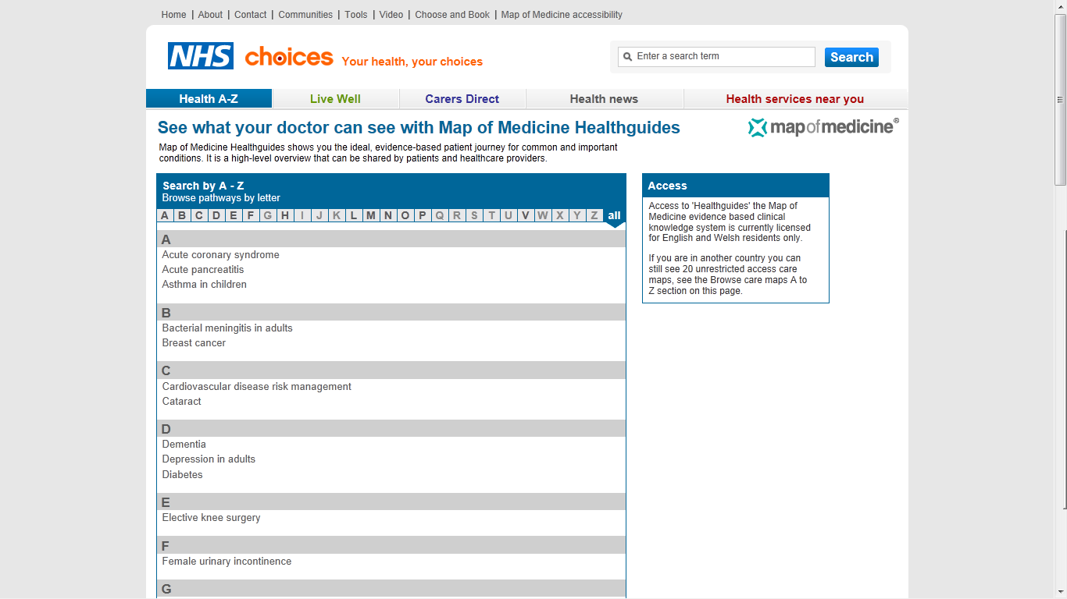
Map of Medicine Healthguides – index (restricted US version)

Slide 21
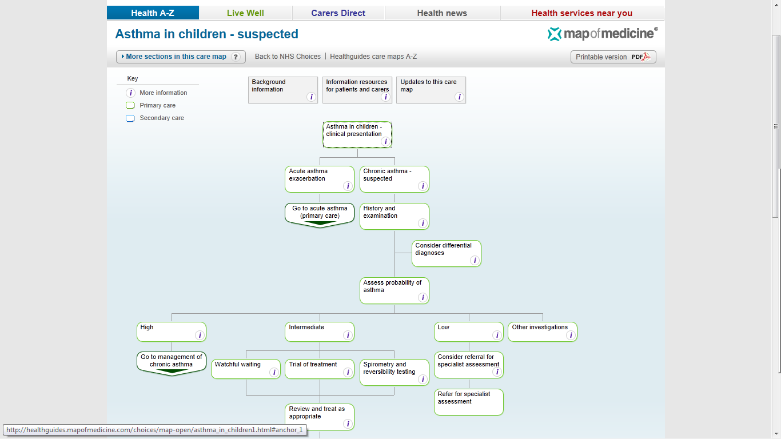
Map of Medicine Healthguides

Slide 22
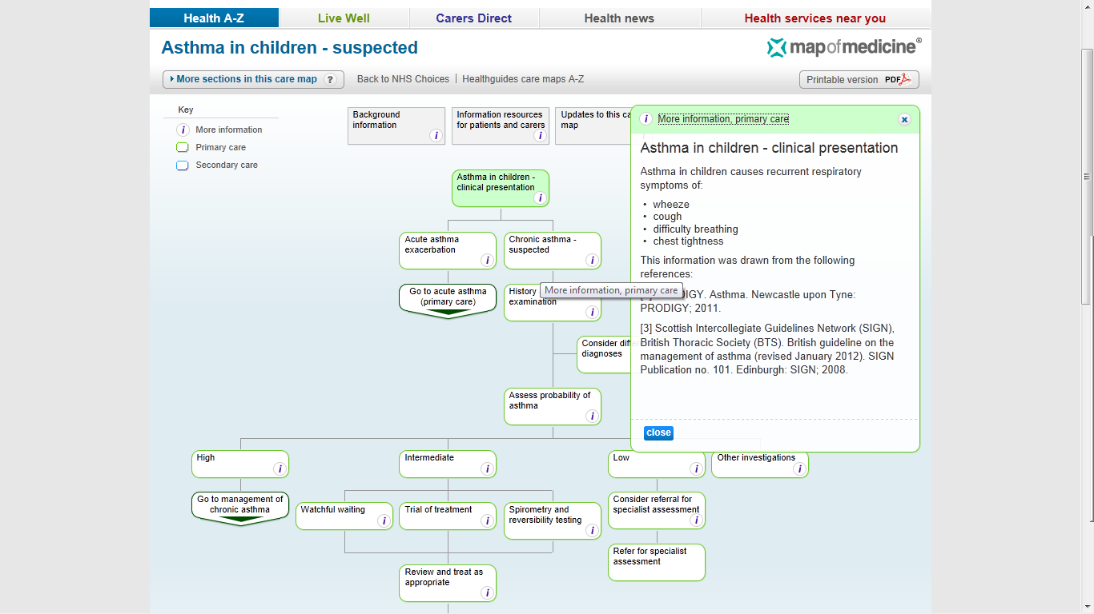
Map of Medicine Healthguides

Slide 23

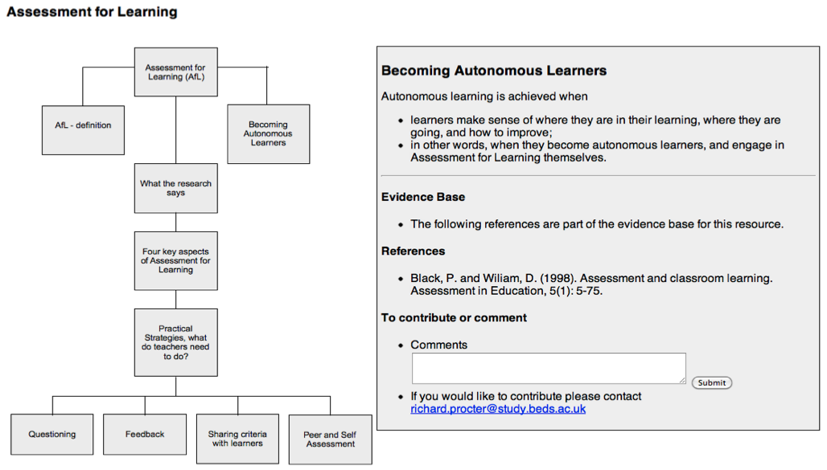
Tool 1 MESH example
Notes:
MESH uses online graphical flowcharts/mindmaps or pathways as a way of presenting complex knowledge, each node in the pathway provides a link to a summary of the evidence and to the resources used for the summary.
The resources presented in these online pathways may be of any web based format such as text, audio or video and are underpinned with rigorous high quality research evidence.
Run as a journal would - with an editorial board and peer review
We are in a pilot phase with this and welcome people to join us in a variety of capacities - editors, contributors, subject experts and reviewers - please let us know of visit the website for more information.

Slide 24
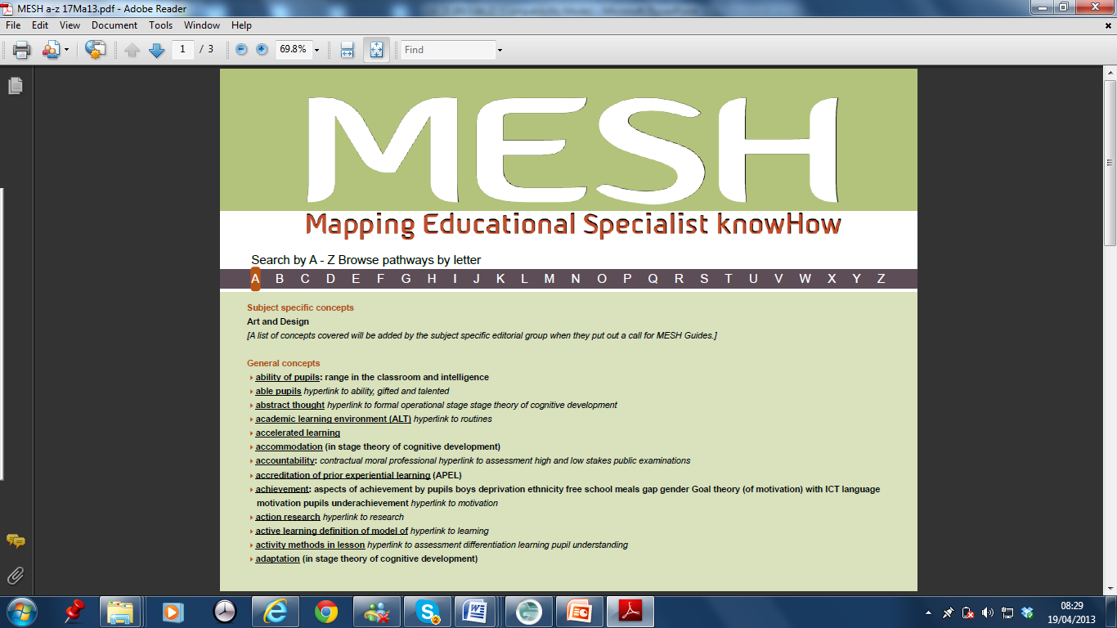
The Teacher Profession Knowledge Challenge : thousands of concepts, fine grained, context specific

Slide 25

Summary
is set up to:
underpin professional judgement with evidence
raise learner attainment through professionalising teaching
is a system, sustainable within current resources, supporting educators to:
pool, build, test and publish knowledge in new ways through world wide collaborations
access to research based advice to improve teaching and so improve learning outcomes
to work cost-effectively to revisit and update research and to re-publish research in ways previously not possible.

Slide 26

Tool 2 on-line communities
EdComms
Notes:
Environment for professional networking of educators
Based on the robust UK award winning platform developed to support knowledge sharing across local government which grew to 100,000 users in over 1000 communities within a few years.
Private or public community workspaces with library, wiki, forum, email alerts, members list, blog, and ability to create sub-communities, people finder.
All members are known - as a profile is created at registration (which is free)
Allows all interested in education to join the public communities and to apply to join private communities
Communities can be set up in minutes

Slide 27
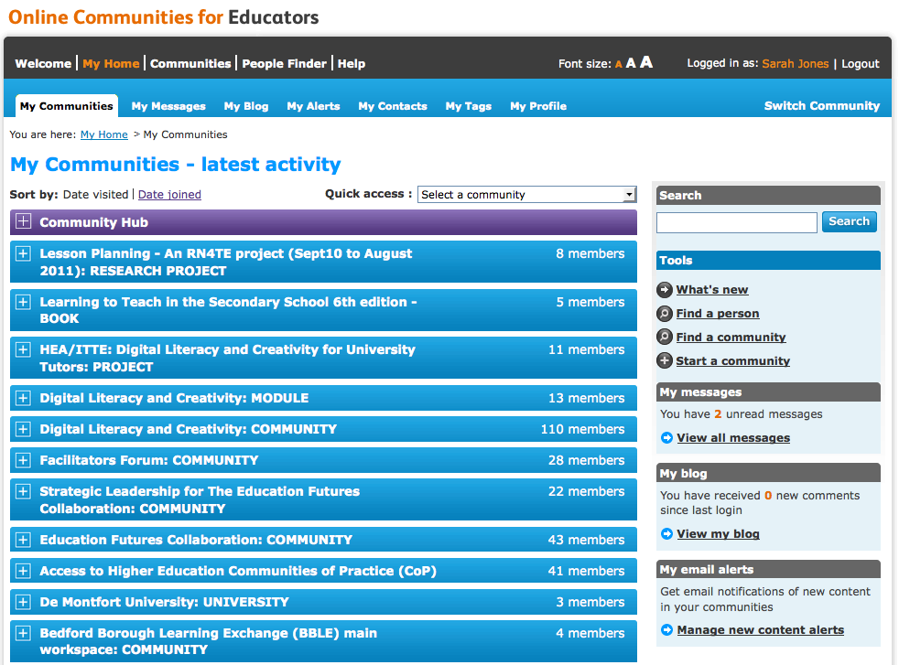
Tool 2: EdComms
Notes:
Explain the blue bar
Tools on Right
Community Hub purple
Naming conventions
Importance of My Profile - use KEYWORDs to describe your research interests

Slide 28
Tool 2 EdComms uses
Examples of use from the Pilot:
General communities to share and develop practice
Writing books
Cross-institution research
Journal articles
Cross-department/institution PhD students
Funded Projects
Finding partners for projects – research, publication, collaboration, bid writing

Slide 29
Working differently: summary
New Practices:
  cost effective methods for scaling up small scale research
  On-line research collaboration (national/international)
  rapid evidence review groups
  rapid evidence based responses to government policy
  crowd sourcing data/surveys
Access and coverage: thousands of concepts have to be mastered access and approach like wikipedia
Connectivity: EdComms a flexible e-infrastructure connecting people and communities like the physical network of motorways.
Notes:
Stenhouse’s idea was for synthesis across action research studies using extensive collaborations between researchers and practitioners

Slide 30
Who? Education Futures
Collaboration www.edfuturescollaboration.org
Founding Members include:
ICET (International Council on Education for Teaching)
UK: to date:University of Bedfordshire; Core Education UK; University of West of Scotland, King's College London, St. Mary's University College; University of Wolverhampton; Academy for Innovation; Plymouth University, Birmingham City University, De Montfort University, University of Hull.
Associate Members include:
TTRB3; Multiverse; Behaviour 2Learn; EEP; TEAN; Mirandanet; Core Education NZ, HEA, JISC, UCET
Notes:
The Collaboration is managed by trustees from the founder members
Open to all - participatory and needs to grow from the grass roots.
Costs are covered by founder members and as part of the professional work of those involved.
This provides a snapshot

Slide 31
Summary and check list
The Education Futures Collaboration goal is to:
  underpin professional judgement with evidence
  raise learner attainment through professionalising teaching
The focus of the talk was to outline ways of working to
pool, build and test knowledge through world wide collaborations
provide access to research based advice to improve teaching and so improve learning outcomes
develop sustainable processes within current resources
use digital technologies to support new forms of publishing and for international research groups to work cost-effectively to revisit, update research and republish research in ways previously not possible.

Slide 32
Next steps…… you are invited to…..
Contribute Guides or to apply to join an editorial board: see Getting Involved www.MESHguides.org)
Support and create EdComms communities

Slide 33
Websites
Education Futures Collaboration:
the organisation overseeing www.edfuturescollaboration.org
Education Communities: EdComms e-infrastructure for research, development and review groups
www.educationcommunities.org
knowledge maps/MESHguides
www.MESHguides.org

Slide 34
contacts
Linda.lavelle@plymouth.ac.uk
Marilyn.leask@beds.ac.uk
sarah.jones@core-ed.org.uk
syounie@dmu.ac.uk
Thank you and please get involved!

Slide 35
OECD challenge: your response?
What might a ‘knowledge rich’ evidence based education system look like?
What is your view of the moral, contractual and professional accountabilities of teacher educators/ people in your role?
Whose responsibility is it to create this?
What is your role in creating such a system?
What are you doing now that helps or hinders the creation of such a system?
Where is the funding to come from?
Notes:
Big Qs facing teacher educators. In face of pressures on UDEs: REF and associated relevance of educational research, School-based ‘training’ – future looks bleak
Yet there is a further challenge – that of the status of the evidence base itself…..

