Slide 1






KEY COMPETENCES FOR LIFELONG LEARNING
European Reference Framework
Bill Houldsworth

Slide 2
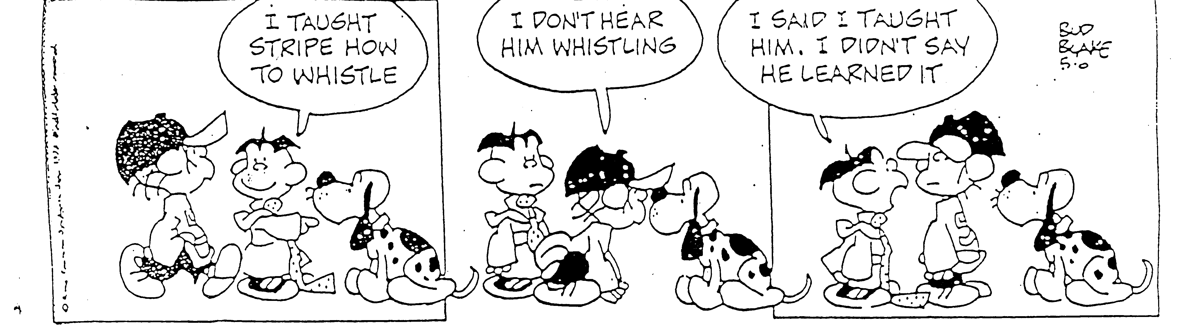
Notes:
2
N.B. this serves as a reminder to them of the importance of ensuring that the learning is paramount.
End the session by making the following points
Observing lessons can have a range of purposes:
it can provide evidence about the quality of teaching and learning;
it can identify good practice as well as areas for improvement;
it can be a tool for improvement, especially when used with the coaching approach;
to be successful the purpose must be clear to both observer and observed;
It is an essential tool for self-evaluation and provides crucial evidence for Ofsted.
Ask them to fill in the evaluation form.

Slide 3
Something in the water!
Building Learning Power
Increasing Learning Power
Multiple Intelligences
Thinking hats
Philosophical enquiry
Learning styles
European Key Competencies Framework.

Slide 4
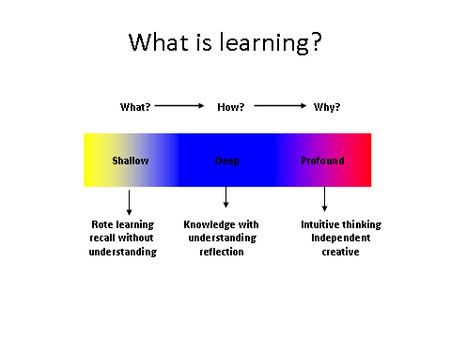

Slide 5
Albert Einstein said:
“It’s a miracle that curiosity survives formal education”
“The only thing that got in the way of my learning was education!”

Slide 6
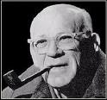
The times we’re in…
“In times of change learners inherit the earth, while the learned find themselves
beautifully equipped to deal with a world that no longer exists.”
Eric Hoffer
Notes:
May want to reflect on relevance of ‘times of change’ – managing change, equipping people for 21st Century etc., package of knowledge no longer good enough…
Explain that ILP seeks to equip people to be really excellent learners for 21st century
6

Slide 7

Double Helix of Learning (McGettrick 2002)
Learning Power
Achievement
Knowledge
Skills
Understanding
Personal Development
Attitudes
Values
Feelings
Dispositions
Motivation
Notes:
Mention the importance of metaphor, for getting complex concepts across. Leaning Power is like the ‘glue’ (the rods) that hold the two parallel strands of the DNA of learning together: the PERSON and the CURRICULUM. They have to ‘get on’! Perhaps too much attention and resource has been given to ‘Knowledge, Skills, Understanding’ AT THE EXPENSE of personalisation. We do not want to swing back like a pendulum to ‘person-centred’ education, but Learner-centred’ education: so learners ‘relate’ to what they learn.
7

Slide 8
Key question 1 that ELLI addresses
What are the characteristics of successful learners ?
Notes:
Possible activity:
Ask people to stand up before explaining the activity- to find a person from another table/area of the room so there is movement and energy
Think of an example where you have, as an adult been a successful learner- what did you learn, why was it so successful, can you identify some of the characteristics about yourself that made the experience effective
Take approximately 2 minutes for each person to describe their example in pairs
Take feedback

Slide 9
The Seven Dimensions of Learning Power
Changing and learning: A sense of myself as someone who learns and changes over time
Critical curiosity: An orientation to want to “get beneath the surface”
Meaning making: Making connections and seeing that learning “matters to me”
Creativity: Risk-taking, playfulness, imagination and intuition
Learning Relationships: Learning with and from others and also able to manage without them
Strategic awareness: Being aware of my thoughts, feelings and actions as a learner, and able to use that awareness to manage learning processes
Resilience: The readiness to persevere in the development of my own learning power
Notes:
What the research shows as the key characteristics of highly effective learners.

Slide 10
Seven Dimensions of Learning Power
  Changing and learning*
  Meaning making*
  Critical curiosity*
  Creativity
  Learning relationships
  Strategic awareness
  Resilience
  vs Being stuck & static
  vs Data accumulation
  vs Passivity
  vs Being rule bound
  vs Isolation & dependence
  vs Being robotic
  vs Fragility and dependence
Notes:
In more detail with the opposite poles
This is the ‘heart of the matter’. Worth dwelling on, explaining each Dimension, both in itself and compared with its opposite (contrast) pole. Refer to explanations at the top of the ‘ELLI Ideas’ pages in Handbook if needed - Chapter 5, pages 53-59) but best in first person (i.e. This is about our sense of ourselves as people who change and learn over time…’ ) It is worth asking people to relate each of them to themselves and/or people (learners?) they know.
Key points (about all of them):
The (blue) contrast poles were given by the research team, for clarity and to create the idea of a spectrum along which we can travel – towards the positive! The last factor to emerge was ‘Fragility and Dependence’ – and that is what the inventory measure – but we use the positive terms for simplicity when talking about ‘Learning Power’
The qualities are ‘plastic’ (i.e. movable) – self-reported levels of each Dimension are susceptible to change, rather than being innate and fixed like a personality type
They can also say as much about the context someone is learning in (i.e. what they envisaged in answering the questionnaire) as about the person’s capacity – i.e. low Strategic Awareness might be because there have been few opportunities to develop it yet
They are all inter-connected parts of a complex whole (Learning Power) not discrete or sealed off from each other, not like ‘styles’ or ‘preferences’: they serve each other and your strong ones can help you work on your weaker ones
They are more far reaching than ‘skills audits’ or ‘cognitive tests’ or ‘behavioural’ typologies as they all contain elements of thinking, feeling and doing: they are holistic and about us as whole people.

Slide 11

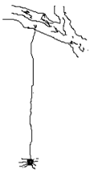


How do we communicate about learning power?
Notes:
Metaphor and story
Images
Identification
Weaving language
Inviting creativity
Spider is meaning making
Ant is learning relationships
Chameleon changing and learning
Owl strategic awareness
Homer - resilience

Slide 12

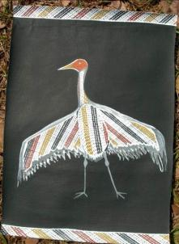
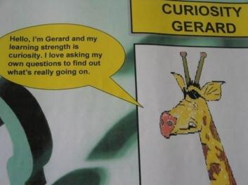
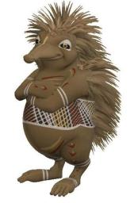
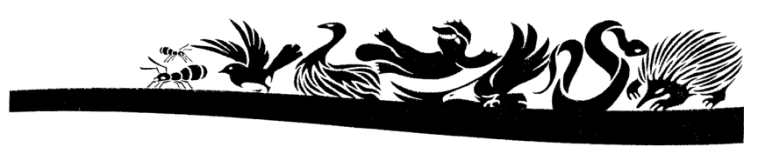
Develop your own icons:
Notes:
The Wild Bird icon is one of a set of images developed by a leader of the indigenous community in Gappawiak, Northern Territory, Australia.

Slide 13
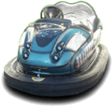

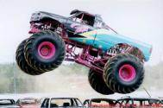
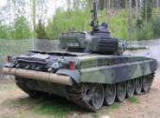

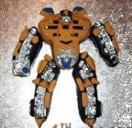

ELLI in 7_2 Our Class Metaphors:
Learning Relationships
Meaning making
Creativity
Resilience
Critical Curiosity
Changing and Learning
Strategic Awareness
Notes:
This is a set of images devised by a Year 8 class in Palmerston High School, Darwin, Australia.

Slide 14
Using stories
Extract from ‘A Learning Journey’
…A bear once set out on a long journey. He wanted to find a new cave to make into his home. He had heard that there were some in the mountains he could see in the distance.
Notes:
This leads us to the second key question that ELLI addresses – How can we assess these seven dimensions of learning power. Well let’s give it a go in an informal way with one of the dimensions – critical curiosity

Slide 15
Critical curiosity vs Passivity
Inspectors will look for evidence of learners being fully engaged in what they are doing and having the process skills to take responsibility for their learning. Enabling learners to use the language of Critical curiosity to describe their learning is a strong motivator.
Notes:
Inspectors, whose visits may well be unannounced, may go further than simply asking questions of individual learners. There are signs they may take whole groups aside and hold detailed conversations with them to see if they really understand the learning processes they are going through and how their knowledge and skills grows. Active engagement is key; passive absorption is simply not good enough.
(From RG/JJ notes) The dimension “Critical curiosity / Passivity” is a key one for linking ELLI and Ofsted; inspectors are keen to see pupils actively engaged in learning, not passively absorbing; ELLI gives learners a vocabulary for active engagement – this is important because learners need to be able to explain to inspectors how they engage actively: asserting it is not enough. This is a key general issue: we need to show exactly what impact ELLI has on learners and learning; simply asserting that it does is not good enough. (21)

Slide 16
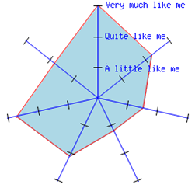
Changing and learning
Critical Curiosity
Learning relationships
Meaning Making
Strategic Awareness
Creativity
Resilience
Notes:
Briefly explain the profile. Relate to the four corners of the room in previous activity. Can they ‘imagine’ their current profile? Can they ‘see’ changes as they have engaged in lifelong learning or have they remained with a similar profile for much of their lives. This brings us on to the third key question that ELLI is concerned with -

Slide 17
ELLI is a powerful, peer reviewed and successful tool that enables us to:
  accurately and reliably identify where an individual is on all 7 dimensions through completing an online self-report involving answering 72 questions
  display the results on an easily understood graph
Notes:
Be clear about peer reviewed, steeped in research and already successfully used in different countries and with individuals from contrasting backgrounds

Slide 18
Your ELLI profile?
On the profile have a ‘guess’ where your score would be on the 7 dimensions
(ignore the current shape)
Notes:
This is so important. Imagine the impact that ELLI can have on learners of any age, but particularly children, if it is used to help them find out about these dimensions of learning power, to reflect on these dimensions of learning power, to focus on them, to develop them, to learn how to be a successful learner, to practice being a successful learning, to maximise potential by building on identified strengths and developing those dimensions that don’t come quite so naturally. We don’t need to imagine. We already have hundreds of stories of change. For example.

Slide 19
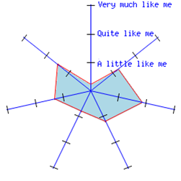
Changing and learning
Learning relationships
Critical Curiosity
Meaning Making
Strategic Awareness
Creativity
Resilience
Notes:
Here is an example of the individual feedback – an ELLI profile. NOTICE: no numbers! No validity in comparisons of single profiles (their size is affected by the caution or exuberance with which respondents tend to select mainly middle, or mainly outer buttons on the Lickert Scale. This is a ‘Type 1’ profile, as they were found in an early study to cluster into 3 groups: the first being fragile, ‘shrunken’ profiles on most dimensions.

Slide 20
5 Levels of impact
The individual learner
Coaching or mentoring
Adapting learning and teaching in the existing curriculum
Curriculum design
Systemic change – leadership for a learning culture
Notes:
Explain that it is the five levels of impact that it responsible for change and that schools and organisations can engage in different ways. It is this that BPN will be looking at developing with schools etc in the near future, training ELLI champions and promoting this opportunity for schools.

Slide 21
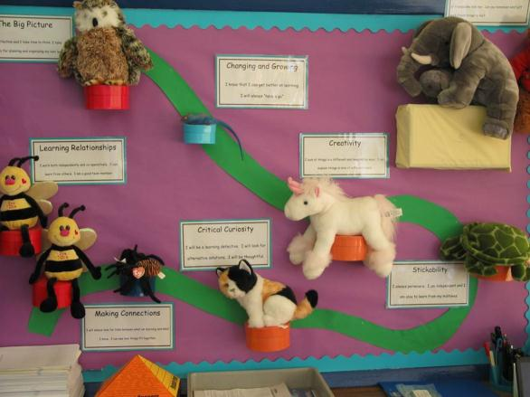
Posters and displays
Notes:
Embedding the Seven Dimensions in the environment

Slide 22
‘Teachers and other adults generate high levels of enthusiasm for, participation in and commitment to learning.’
ELLI is highly energising for teachers – it enables them to reconnect to what matters most in education – learning and achieving
“It is when the teachers start to get together it becomes so vibrant and exciting. We are using all their wealth of expertise to make the (ELLI) project explode.”
Notes:
ELLI is highly energising for teachers – it enables them to reconnect to what matters most in education – learning and achieving. By doing their own ELLI profiles they create a context and vocabulary to share understandings of their own learning processes and that of their pupils. In effect, the seven dimensions become aspects of a compendium of teaching and learning practices which teachers can learn to use as appropriate to their learners.
It is the language for learning which teachers and students really appreciate. At last they have a way to discuss how they can move forward in a way which is personal to them, yet understood by their teachers. Learning becomes something manageable and interesting to talk about.
You can give difficult challenges now and because of the learning powers they know it is going to be hard, and that is okay. They ask “What can we do? we can be spiders” (T) (explain what spiders are – Learning metaphor for meaning making
22

Slide 23
‘They (teachers) use well judged and often imaginative teaching strategies that, together with sharply focused and timely support and intervention, match individual needs accurately’.
The ELLI Learning Power diagnostic enables students and teachers to know what they need to improve.
ELLI has developed and deepened Teachers’ understanding of pedagogy and of how children learn. Head Teacher
Notes:
The ELLI Learning Power diagnostic enables students and teachers to know what they need to improve.
3.1 After four months of working with ELLI ‘learning powers’ the majority of pupils were able to demonstrate fluency with the vocabulary of the learning dimensions and reflective self-awareness and enthusiasm for learning when explaining how they wanted to develop strength in a particular learning dimension.
Understanding the 7 dimensions found in highly effective learners enables teachers to think and speak in a way which supports learning and devise strategies for learning.
23

Slide 24
‘Teaching promotes pupils’ high levels of resilience, confidence and independence when they tackle challenging activities.’
Learning Relationships and Strategic Awareness
Students become more confident, resilient and independent when they know what it is they could do to improve their result through ELLI.
I used to be a giving up sort of person. Since the
Learning Powers have come in, them just being
there, they remind you to keep going. Y6 Student
Notes:
(from RG/JJ notes) English and maths across the curriculum are all important; they must demonstrably appear in all subjects and both learners and teacher need to be able to explain how they do. Teachers of all subjects need to know how English and maths are embedded and this must be evident to learners. This links with learners actively taking control of their learning. This would link with Learning Relationships and Strategic Awareness(13)
Students grow in confidence as the strategies they and their teacher put in place start to work.
‘You can get into the telling mindset. Now this (ELLI) is helping children take responsibility.’ (T)
It’s just like a new way to learn things. It’ll help you to learn things if you use it
correctly. Secondary school pupil The Outdoor Dimensions project
“When you’re on your own and you fail you think down on yourself but when you’re in a team people can support you. All the animals (learning power metaphors) are connected together!
Secondary school student
I predict that if we had continued as we had been doing (ie pre ELLI) we would be very worried by now. Each half term teachers meet to discuss the ‘stuck’ children. Again and again it was lack of resilience, children giving up. Now we don’t hear this from the Teachers any more. We had strategies, but they weren’t making any difference. ELLI has changed this for us. (Headteacher)
Behaviour is generally good is now where it wasn't before. Children are now self in regulating taking responsibility for their actions. (Deputy Headteacher)
Looking at some of these children (those with scores below 55) it is incredible to see how they have come on, I would never have thought it. (HT)
24

Slide 25
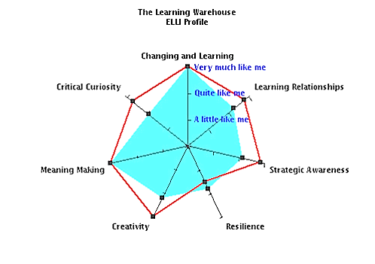
A Picture of change
Notes:
Figure 1: Pre- and post profile for Student 1:
Foundation 2 to first year ICT Degree Student
Highlight the change. How does ELLI achieve this?

Slide 26
ELLI – key facts summary
University of Bristol
7 Key Dimensions of Learning
A validated self-audit tool (ELLI) to measure and increase ‘Learning Power’.
Strategies for increasing learning power
“Now I have got a new way of learning for myself” Secondary school student

Slide 27
Good learning
All pupils have to think. Pupils:
ask questions themselves to take their learning forward
have a 'can do' attitude to learning
are able to explain processes they have used
can make mistakes and learn from them
know what success looks like
have cognitive conflicts (using what they have learnt in the lesson to draw different conclusions from those previously held)
can connect the 'unconnectable‘ (thinking creatively)
find their own route to a solution
transfer their skills to different situations

