Slide 1



Comenius Regio
Collaborative Learning in Information and Communication Tecnologies
Mª Luz Ares Fandiño
Mª Blanca Fraga Lago

Slide 2
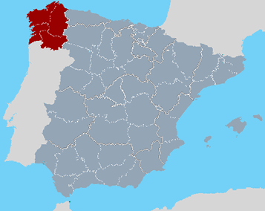
Regional Education
Authority. GALICIA

Slide 3
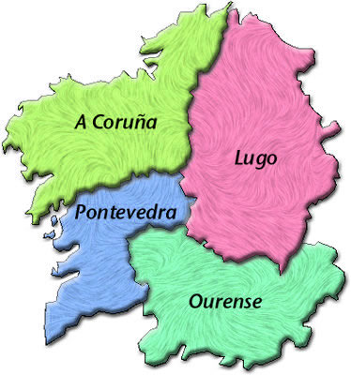
Galicia

Slide 4
Galicia
2.738.591 Inhabitants
Capital city: SANTIAGO DE COMPOSTELA (90.000 inhabitants)
2 Official languages:
GALICIAN/SPANISH
Santiago Pilgrimage Way
CAMINO DE SANTIAGO
Cultural heritage by UNESCO

Slide 5
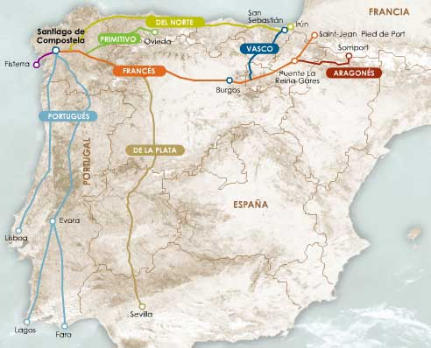

Slide 6
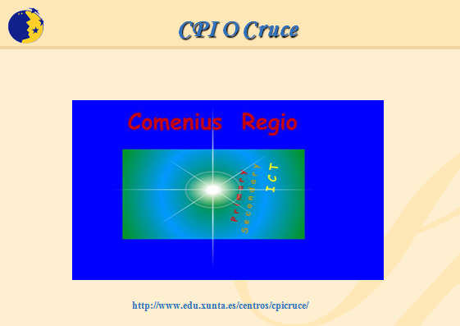

Slide 7
…
Proxectos Comenius 2: EFELCREN
Proxectos lingua 2 : L’ Europensemble
Proxectos de difusión: IEPTL
IPMTOOLS Com,course

Slide 8
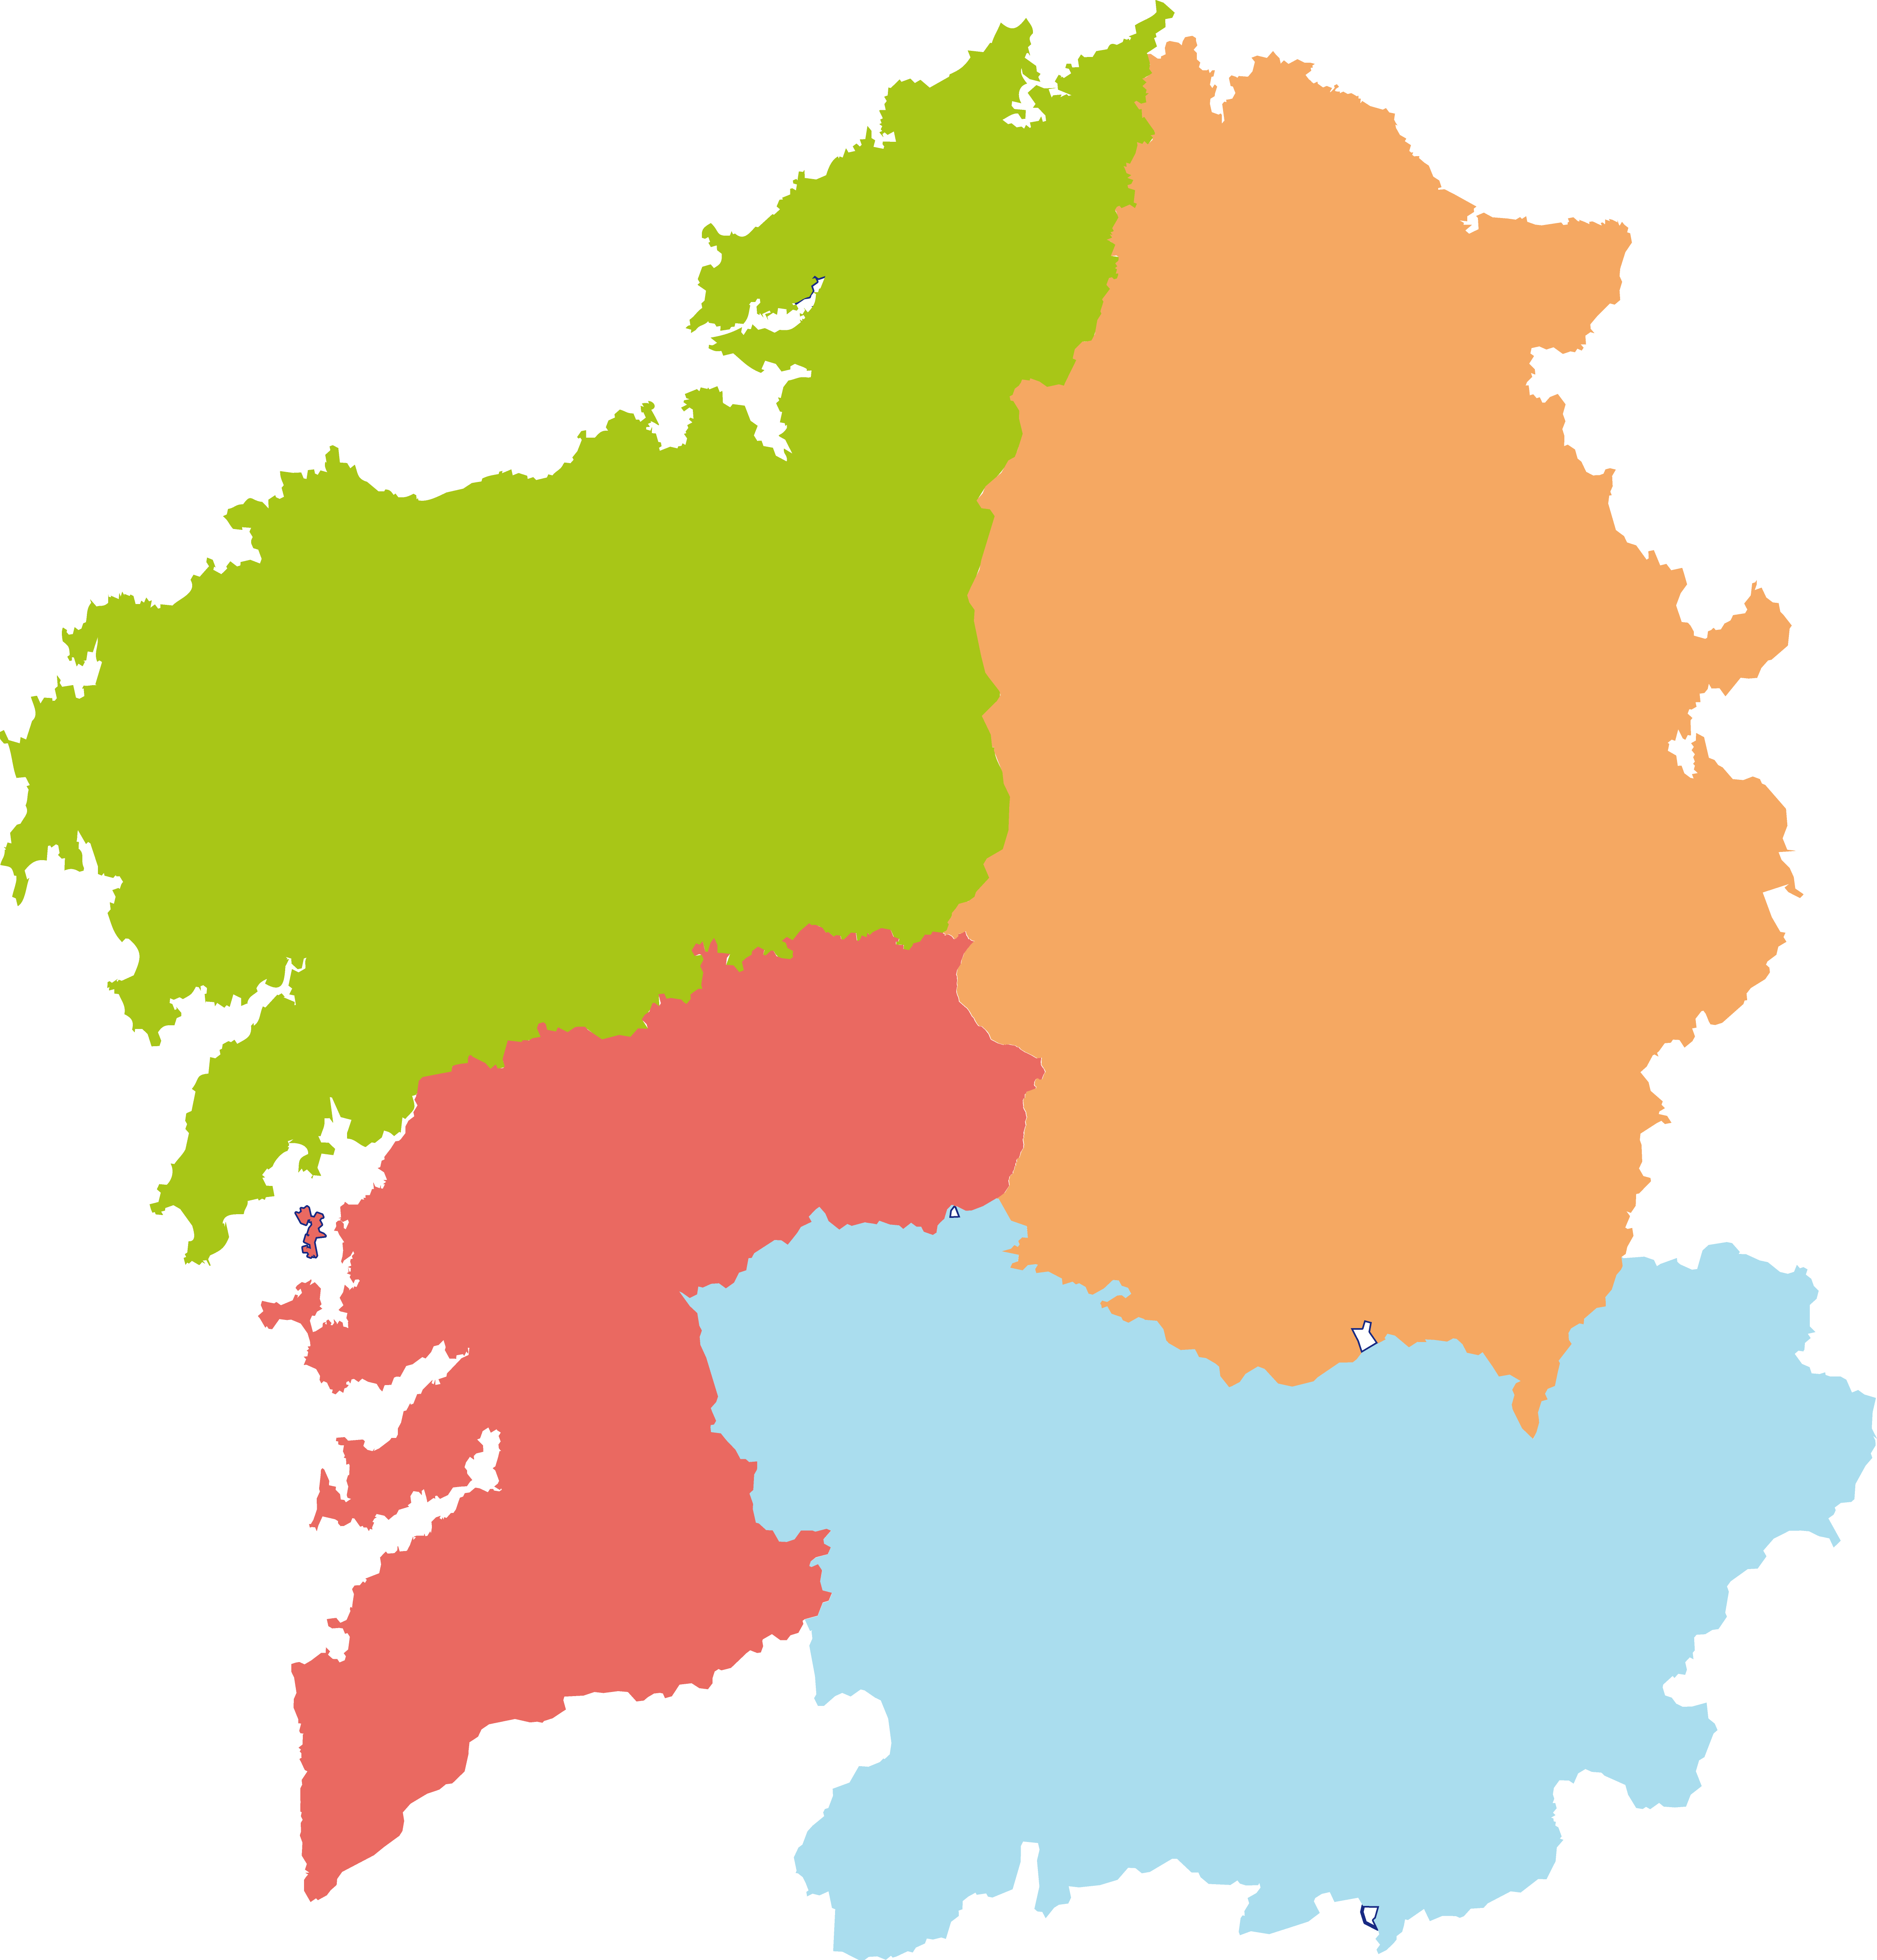
Similarities between Devon and Galicia

Slide 9
Importance of ICT
New learning approaches
Outcomes
    Catalogue of EU Standards of ICT competences for Primary and Secondary Schools.
    Programmes for the training of schools and development of trainee teachers, teachers and support staff.

Slide 10
CLICT
  http://centros.edu.xunta.es/cpiocruce/comeniusregio/project.htm

Slide 11
University of Santiago de Compostela
New projects are on it´s way
    Both administrations are studying the way to
  improve foreign language teaching.

Slide 12
    THANK YOU VERY MUCH
    FOR YOUR
    ATTENTION
Mª Luz Ares Fandiño
Mª Blanca Fraga Lago
programas.europeos@edu.xunta.es
www.edu.xunta.es/web/programaseuropeos

